Slide 1
“A Christmas Carol” Some Background Information

Slide 2
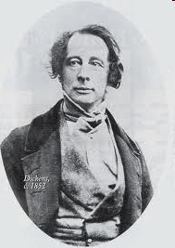
By Charles Dickens 1812-1870

Slide 3
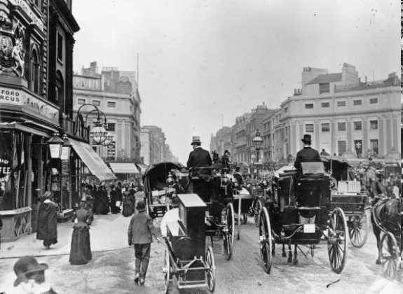
The Setting: Victorian London

Slide 4
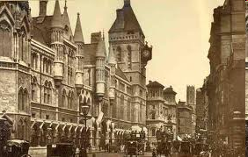
The Setting: Victorian London

Slide 5
Background A Plea for the Poor
Charles Dickens fist published “A Christmas Carol” in 1843.
At that time, about 1/3 of the people in London were living in poverty and hunger.
The city was dirty and overcrowded, and jobs and houses were in short supply.
Many children were forced to work instead of staying in school

Slide 6
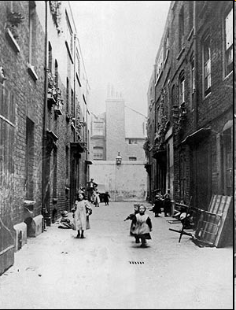
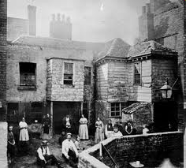

Slide 7
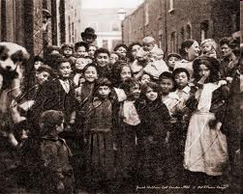
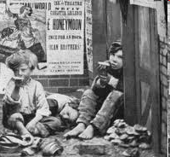

Slide 8
In Victorian England, poor people usually did not get much help.
Even young children, sick people, and the elderly went without assistance from the government or charities.

Slide 9
If you were a poor, out of work Londoner during this time, these were your options:
Beg on the street
Go to a workhouse
Be thrown into prison

Slide 10
The Workhouses
Workhouses were institutions where people were put to work in exchange for food and shelter.

Slide 11
People in Workhouses often
Had little or no heat
Used rags for blankets
Did not get nearly enough food
Were severely overworked and even beaten

Slide 12
Debtor’s prison
Until 1869, in Britain, unpaid debts resulted in a prison sentence. Debtor’s prisons were privately owned, so the conditions of the prisons varied. Most were overcrowded, and prisoners were treated terribly.

Slide 14
English Money
Pound
Shilling = 20 shillings was the same amount as 1 pound.
Pence = (like our penny) and a 12 pence made a shilling.
Farthing = ¼ pence

Slide 15
Money continued
Ha’ penny = ½ pence
Tuppence = 2 pences
Quarter farthing = 1/16 pence
Florin = 2 s
hillings
Crown = 5 shillings
Sovereign = 20 shillings
Guinea = 21 shillings

Slide 16
Pound

Slide 17
Shilling

Slide 18
Farthing

Slide 19
Ha’penny

Slide 20
Sovereign

Slide 21
Earnings
Bob Cratchit earned 15 shillings a week.
He would have spent an entire week’s wages on their Christmas meal.

Slide 22
Gruel
A thin, soupy form of porridge made of boiled ground grain such as millet, oats, or barley, or even acorns or peas.

Slide 24
Other settings in the story
Camden Town—the unfashionable Market area in the northern part of Old London where Bob Cratchit and his family lived. Charles Dickens lived here as a boy.

Slide 25
Unhappy Childhood
Charles Dickens’ childhood in England provided material for many of his stories.

Slide 26
Unhappy Childhood
When Dickens was 12 and living with his family in London, his father was put in prison for not paying his debts. Young Dickens had to leave school to work in a rat-infested factory to help earn money for his family. The hopelessness and shame he felt there affected him deeply.

Slide 27
The Industrial Revolution & Child Labor

Slide 28
The Industrial Revolution: A time of change
The introduction of power-driven machinery
Growth of factories
A huge increase in the production of goods
A shift from a rural agricultural society to a more urban one.

Slide 29
The Industrial Revolution in England
The Industrial Revolution of the 19th century made possible the manufacture of cheaper toys and goods for people to exchange with each other.
It created a class of poor factory workers who lived in miserable, crowded conditions, and it also created a class of wealthy business owners.

Slide 30
A Christmas Carol A Plea for the Poor
Charles Dickens wanted his novel, A Christmas Carol, to be “a plea for the poor.”
In A Christmas Carol, Dickens urged these wealthy citizens to give to the poor at Christmas, helping to establish the tradition of charity during this holiday season.

Slide 31
A Christmas Carol A Plea for the Poor
The book was instantly and widely popular, and as Dickens had hoped, it and his other writings did affect how his readers felt about the social conditions of their time.

Slide 32
The Revival of Christmas Traditions
A Christmas Carol, is also often credited with reviving an interest in Christmas celebrations, such as decorating Christmas trees and giving gifts.

