Slide 1
Symbolism
Meanings beyond the obvious
Notes:
‹#›

Slide 2
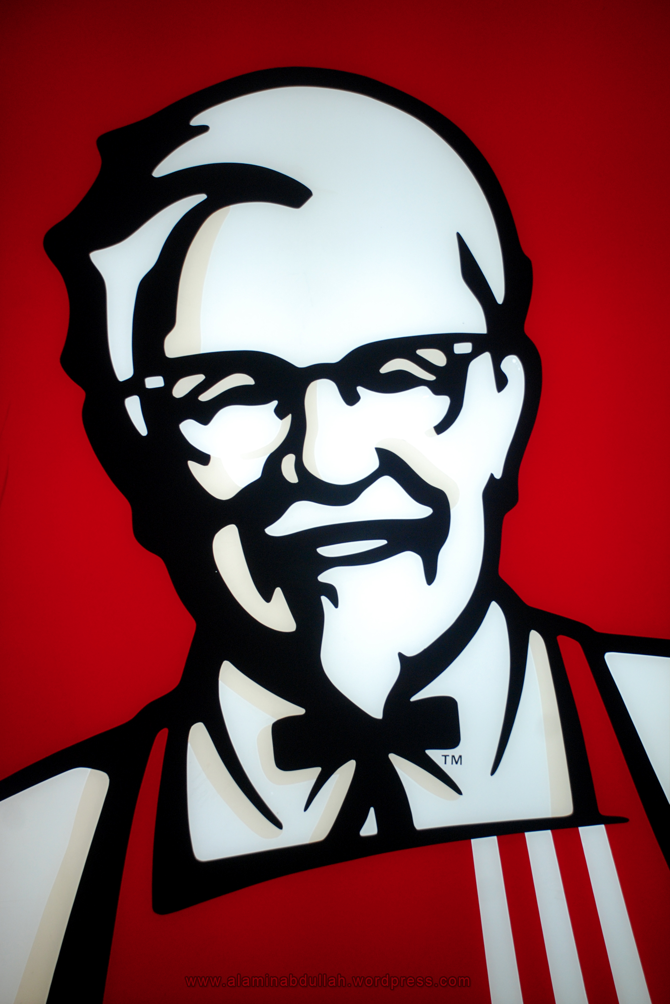
Write down 10 words that you think of when you see this symbol

Slide 3
A symbol is…
A symbol is an image which suggests or represents something other than itself.
(In other words, when you use something tangible to represent something intangible) .
We see symbols every day…
Notes:
‹#›

Slide 4
In poetry and literature, symbolism…
creates a direct, meaningful link between…
an object, scene, character, or action
and
abstract ideas, values, persons or ways of life.
Notes:
‹#›

Slide 5
In other words….
Symbolism is when you use something tangible to represent something intangible
“But Mrs. Eynon, I don’t know what those words mean!”
Notes:
‹#›

Slide 6
Tangible vs. Intangible
Tangible
Things that you can touch
Flag
Autumn leaves
Eagle
Peace Sign
Wedding Band
Water
Flowers
Dove
Intangible
Things you cannot touch
Respect Affection Wishes Romance Disdain Meaning Happiness Angst Running Ego
Notes:
‹#›

Slide 7
For Example!
Love is like a blue stone because it is tough, yet breakable at the same time.
Intangible
Tangible
Notes:
‹#›

Slide 8
Common Symbols
Let’s take a look at a few symbols that our commonly found in literature
Notes:
‹#›

Slide 9
Symbolism
A river can represent the flow of life…
… or its depth may represent the unknown…
… the water might be purity…
… or there could be dangers beneath the surface.

Slide 10
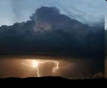
Symbolism
A walk into a tunnel – or change from day to night – could show movement from good to evil, or that something bad is coming…
A storm at a critical moment can represent the intense emotion and trouble…
And dawn may show the end of conflict, the “start of a new day.”

Slide 11
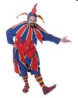
Symbolism
In Poe’s “Telltale Heart,” the sound of the beating heart represents the man’s guilt…
… and a character’s appearance can be symbolic – in Cask of Amontillado, Fortunato wears a fool’s costume – and he is, in fact, a fool for trusting the narrator.

Slide 12
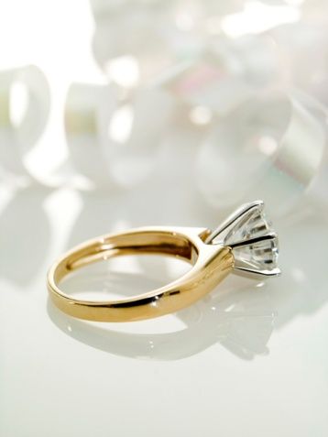
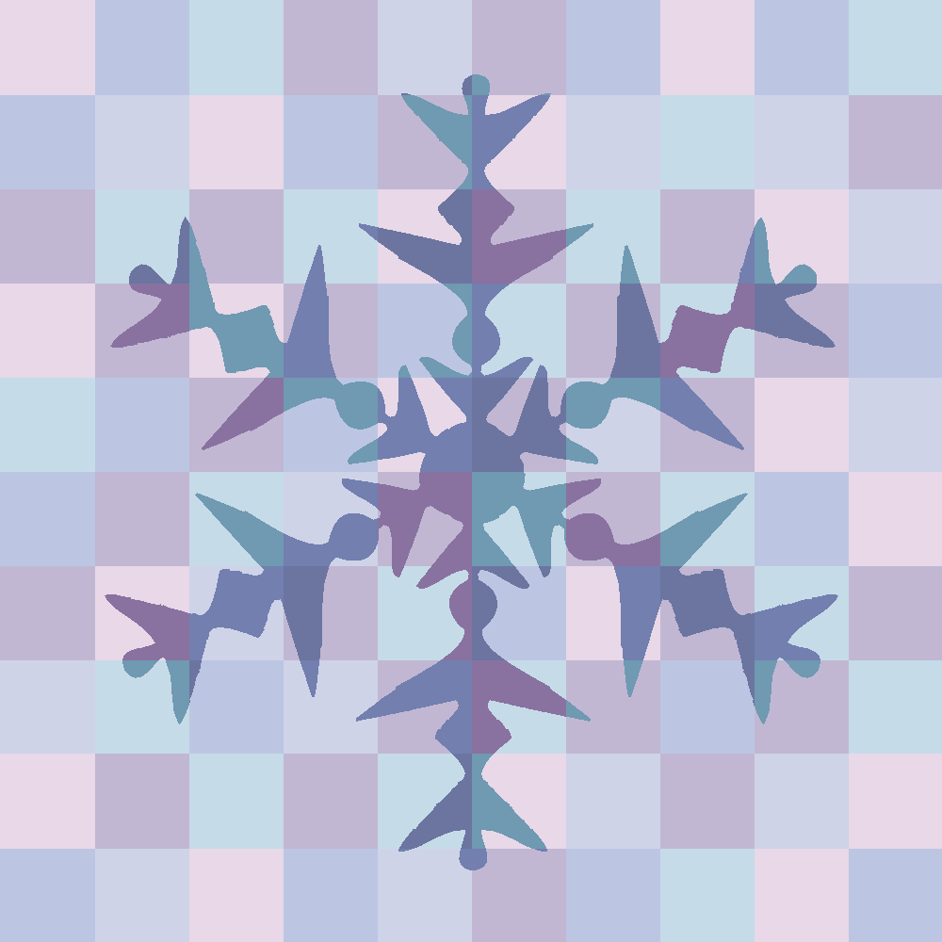
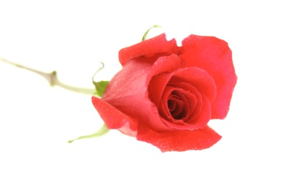
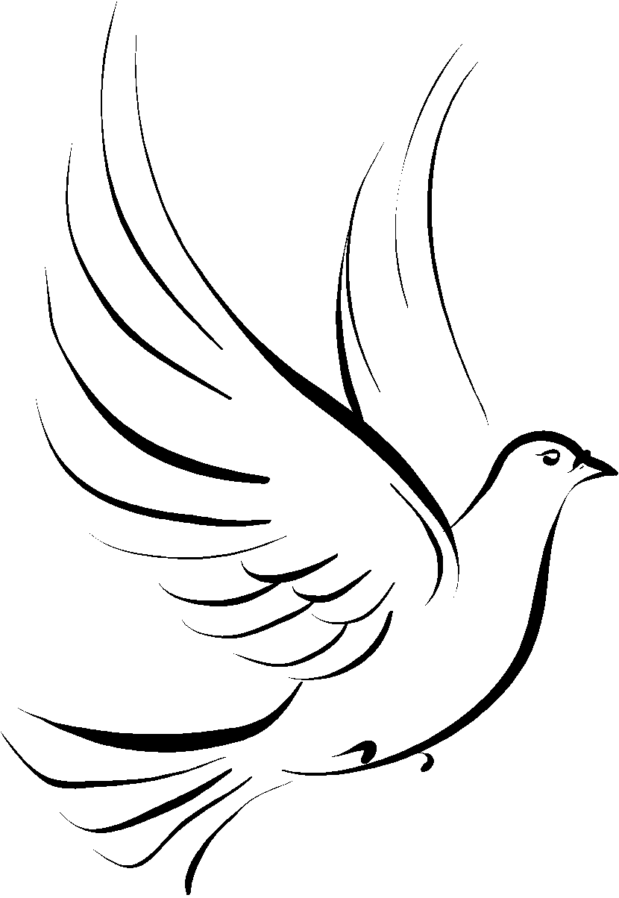
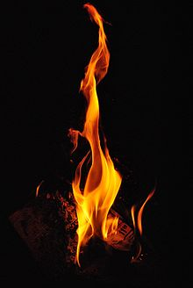
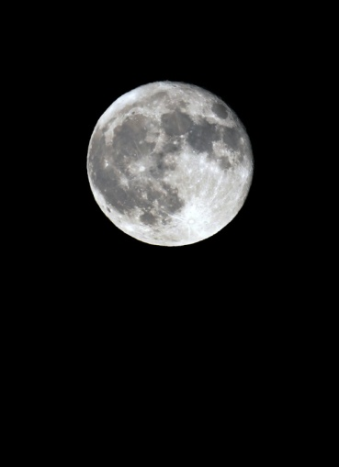
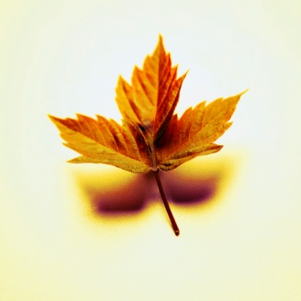
HOW MANY SYMBOLS’ MEANINGS CAN YOU IDENTIFY?
2
1
6
3
4
5
7
11
9
8
10
12
15
14
13
16
17

Slide 13
Let’s try a few….
Hate
Friendship
Love
Grief

Slide 14
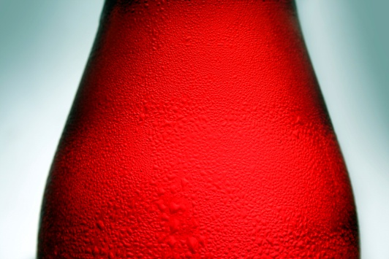
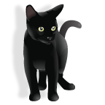
Colors can be symbolic too!
Red
Green
White
Black
Blue

